Slide 1
CSS Flex&Grid

Slide 2
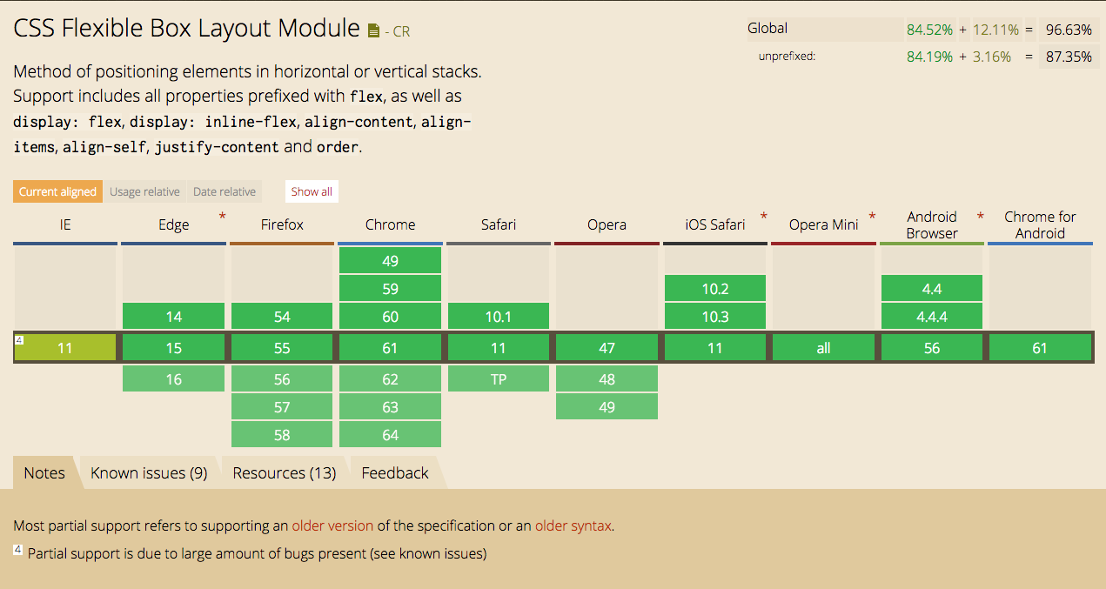

Slide 3
